Slide 1

Structured Query Language(SQL)

Slide 2
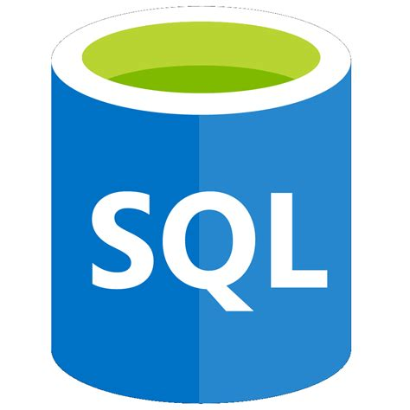
Objectives
Describe what is meant by Structured query language
Identified different categories of Structured query language (SQL)
State what is meant by Data Manipulation Language
State what is meant by Data definition Language

Slide 3
Structured Query language

Slide 4
Structured Query Language (SQL)
SQL is a programming language designed to manage data stored in a relational database management system (RDBMS).
SQL stands for the structured query language.
SQL consists of a
data definition language (DDL)
data manipulation language (DML)
SQL can be used to share and manage data, particularly data that is found in relational database management systems, which include data organized into tables.

Slide 5
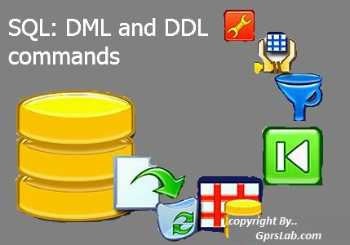
Categorization of SQL Operations
The instructions that are used to communicate with the database using standard SQL fall into different sub-languages.
The two main categories are
DDL Data Definition language
DML Data Manipulation Language

Slide 6
What is SQL DDL?
Data Definition Language is a computer language used to create and modify the structure of database objects in a database helps you to define the database structure/schema. It help you to create the structure of the database and the other database objects.
Some common commands used with the DDL
CREATE – is used to create the database or its objects (like table, index, function, views, store procedure and triggers).
DROP – is used to delete objects from the database.
ALTER-is used to alter the structure of the database.
COMMENT –is used to add comments to the data dictionary.
RENAME –is used to rename an object existing in the database

Slide 7
Data Manipulation Language DML
DML is short name of Data Manipulation Language which deals with data manipulation and includes most common SQL statements which is used to store, modify, retrieve, delete and update data in a database.
The different DML statements are as follows
SELECT Statement - retrieve data from a database
INSERT Statement - insert data into a table
UPDATE Statement - updates existing data within a table
DELETE Statement - Delete all records from a database table

Slide 8
Syntax used in SQL
SQL is a declarative language; therefore, its syntax reads like a natural language.
An SQL statement always begins with a verb that describes the action such as select, update ect
Example
SELECT expressions
FROM tables
WHERE conditions;
SELECT first_name
FROM employees
WHERE YEAR(hire_date) = 2000;
It reads like a normal sentence.
Get the first names of employees who were hired in 2000.

Slide 9
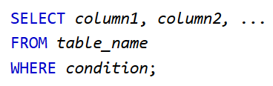
DML commands
The SELECT Statement
The SELECT statement is the most used statement in all of SQL
The syntax used to
The column-list indicates what columns you’re interested in (the ones which you want to appear in the result), the table-list is the list of tables to be used in the query, and search-condition specifies what criteria you’re looking for.

Slide 10
The SQL INSERT INTO Statement
The INSERT statement is used to insert new records in a table.
It specifies into which
table you want to add a record by write the command INSERT INTO table_name,
then the keyword VALUES
followed by the values you want to add in each column inside parenthesis and separated by commas.
INSERT INTO table_name
VALUES (value1, value2, value3...);

Slide 11

Activity
Answer the questions on the given worksheet
Your teacher will help with any difficult you're experiencing.

